Slide 1

COMPUTER SCIENCE ENGINEERING (CSE)
TECHNO INDIA NJR INSTITUTE OF TECHNOLOGY, UDAIPUR
MAY 2022

Slide 2

Team 12 - KAMB Coders
Em Music
Ayush Gadiya - 18etccs016
Bhavika Bhatnagar - 18etccs017
Krithik Jain - 18etccs056
Muskan Panjwani - 18etccs065
Submitted To:
Mr. Aaditya Maheshwari

Slide 3
Drawbacks in current system present in market
In existing system user has to manually select the songs.
Randomly played songs may not match the mood of the user.
It is time consuming to create playlists.

Slide 4
Our Purpose
The main concept of this project is to play songs based on the emotions of the user.
It aims to provide user-preferred music that matches with the user emotions.
It aims to bridge the gap between user and machine understanding.

Slide 5
An emotion-based music player is a novel approach that helps the user to play songs according to the emotions/expressions of the user.
It reduces user load to face the task of manually browsing the playlist of songs and choosing songs that support their current mood and behavior. It recognizes the facial emotions of the user and plays the songs according to their emotion.
About Project

Slide 6
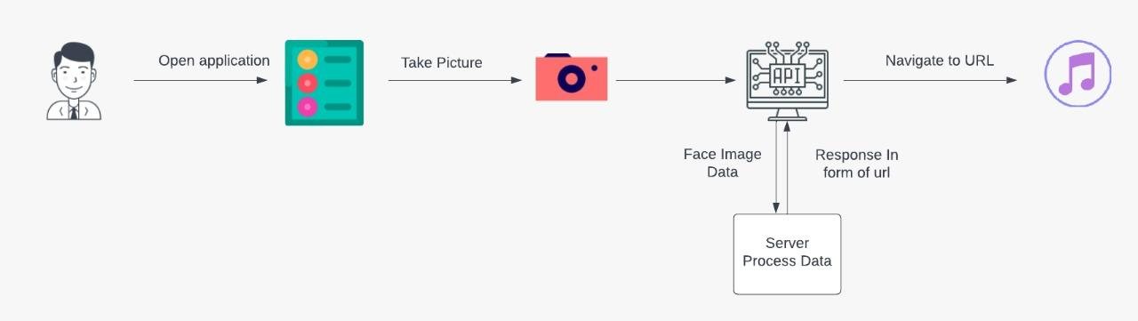

Slide 7
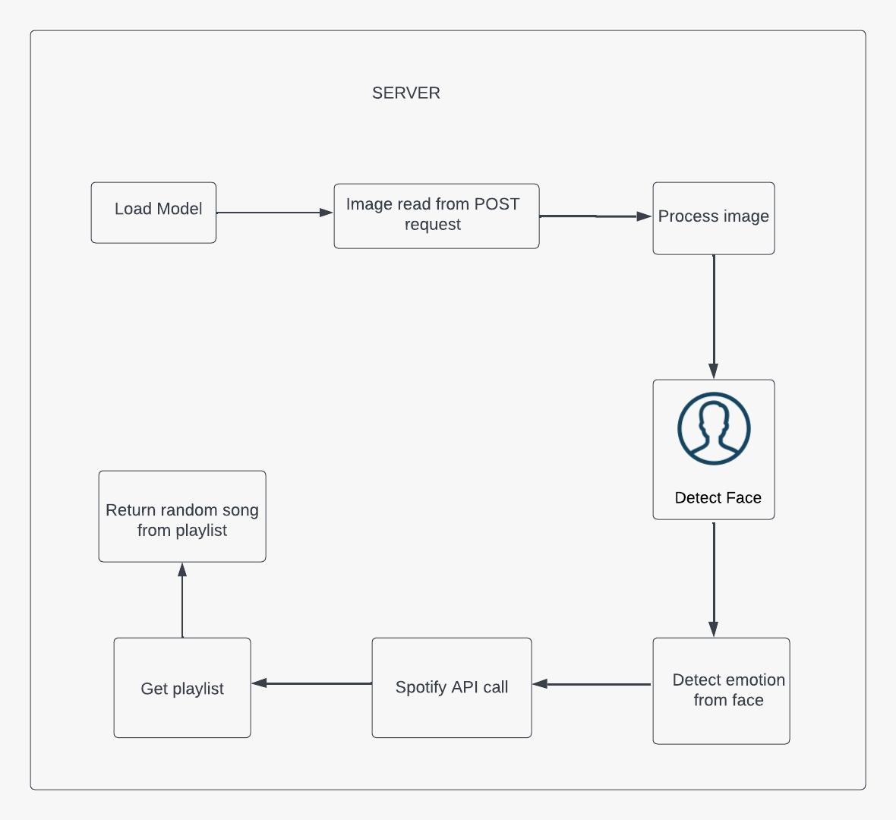

Slide 8
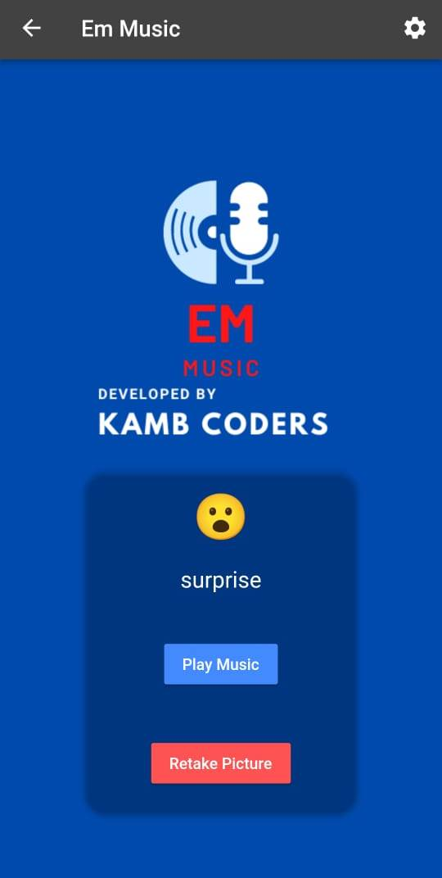
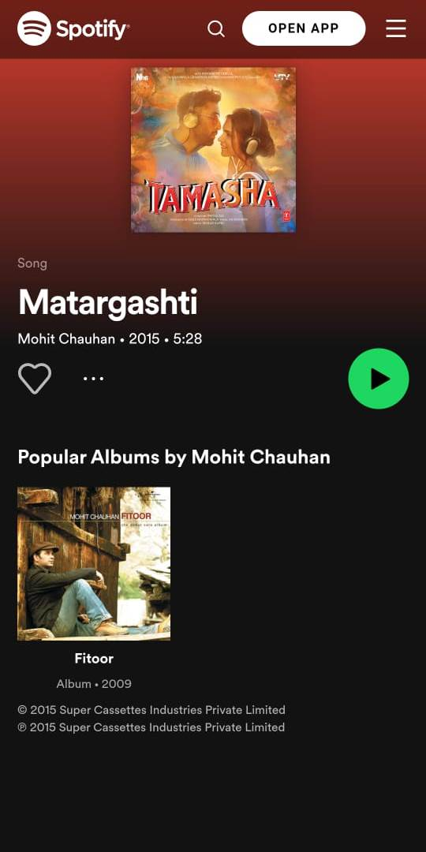
UI of Mobile App

Slide 9
Drawbacks of Projects
Need proper lighting to recognize facial expression
Need an active internet connection
A more Accurate Playlist can be generated

Slide 10
Conclusion
The application developed will reduce the efforts of user in creating and managing playlist. It will provide better enjoyment to the music listeners by providing the most suitable or appropriate song to the user according to their current emotion.

Slide 11
Future Scope
Add voice recognition
Voice/Facial recognition can be made more efficient
To design a mechanism that would be helpful in music therapy treatment

Slide 12
Thank You So Much!!

